Slide 1
NGTP Overview

Slide 2
Agenda
Overview
Building blocks
Design & communication concepts
Interfaces
General aspects
TSDP
LGE NGTP services
Vehicle interface
ASN.1
NGTP messages

Slide 3
Agenda
Overview
Building blocks
Design & communication concepts
Interfaces
General aspects
TSDP
LGE NGTP services
Vehicle interface
ASN.1
NGTP messages

Slide 4

Overview
Next Generation Telematics Pattern
Design pattern, framework, solution,…
Standard building blocks
Standard interfaces
Reusability
Easy integration of legacy systems
Easy integration of new systems
Current version: 2.0 (?)

Slide 5
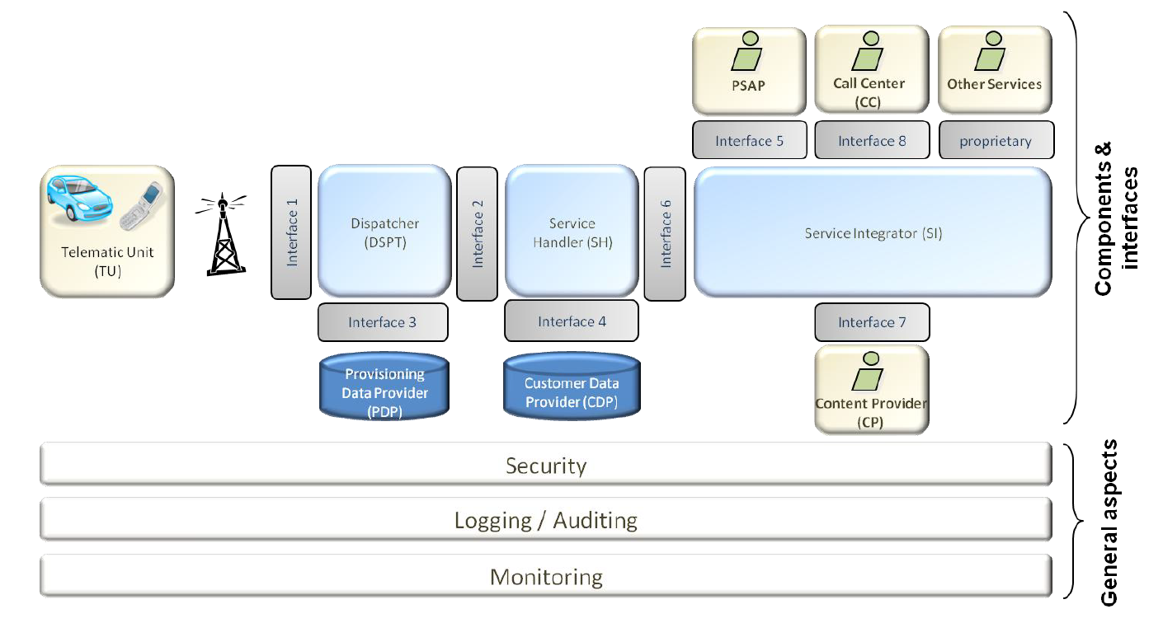
Overview (cont.)

Slide 6
Agenda
Overview
Building blocks
Design & communication concepts
Interfaces
General aspects
TSDP
LGE NGTP services
Vehicle interface
ASN.1
NGTP messages

Slide 7
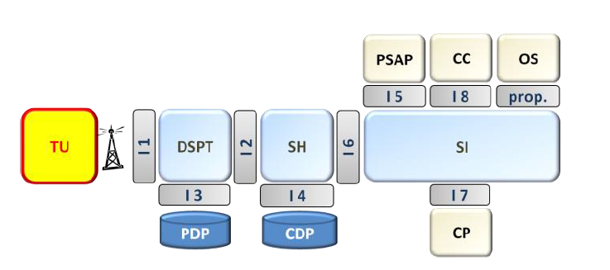
Building blocks
Telematics Unit
Integrated within vehicle
Mobile phone
Out side of NGTP backend
Establish/accept connection with/from DSPT
Send/receive/handle data to/from DSPT
Bearers independent (SMS, WLAN,…)
Messages are uplink (MO)

Slide 8
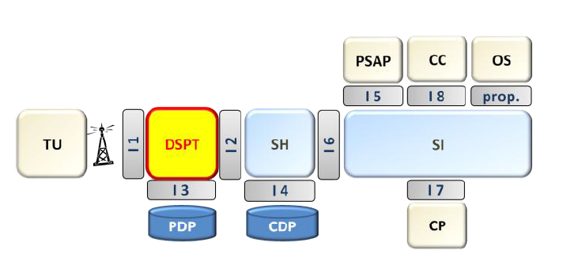
Building blocks (cont.)
Handle HEADER of NGTP message only
Dispatch messages to other components
Send messages from other components to TU
Able to handle of both voice and data messages
Able to switch bearer (SMS, WLAN,…)
Messages are downlink (MT)
Multiple protocols: UDP, HTTP/HTTPS (over TCP), SMS
Resending mechanism stop after receiving DSPT ACK
Encryption/decryption of messages
Dispatcher

Slide 9
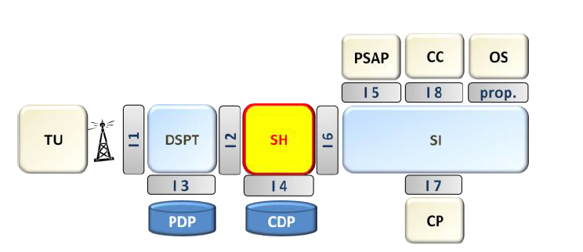
Building blocks (cont.)
Handle SERVICE DATA of NGTP message
Data conversion (from/to DSPT to/from SI)
Support multiple data formats
Forward data to SI/DSPT
Service Handler

Slide 10
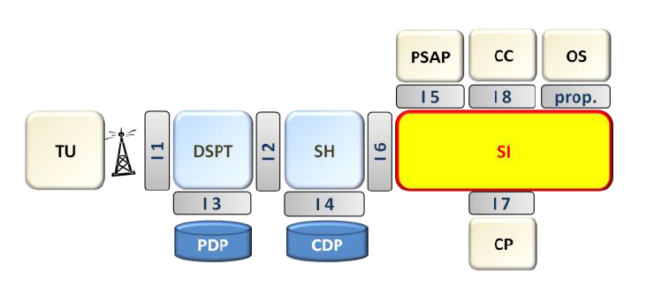
Building blocks (cont.)
Data hub of other components (PSAP, CC, OS, CP)
Send service data (APP ACK) to TU (via SH & DSPT)
Service Integrator

Slide 11
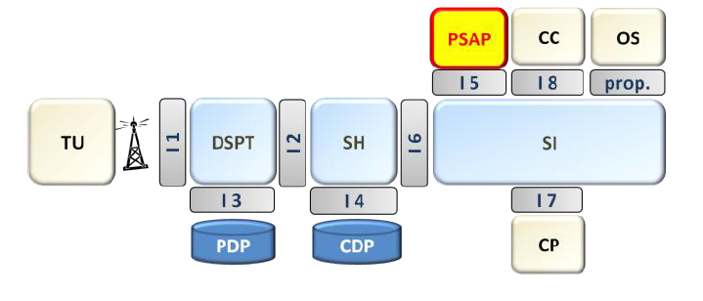
Building blocks (cont.)
Public Safety Answering Point
Emergency calls call center
Region dedicated (dispatcher to current location PSAP)

Slide 12
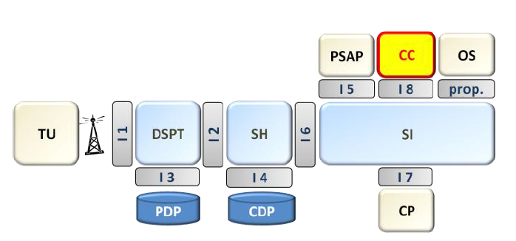
Building blocks (cont.)
Call Center
Deliver vocal data to TU (POI, phone number,…)
Receive data from TU (POI,…)
Connection can be direct between DSPT & CC to reduce latency

Slide 13
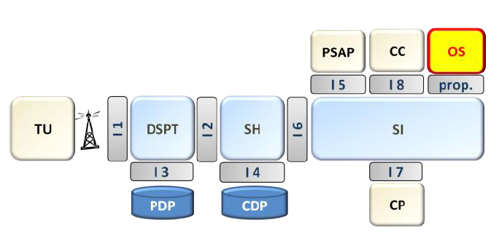
Building blocks (cont.)
Other Services
Any kind of services can connect to NGTP backend (hotel booking,…)

Slide 14
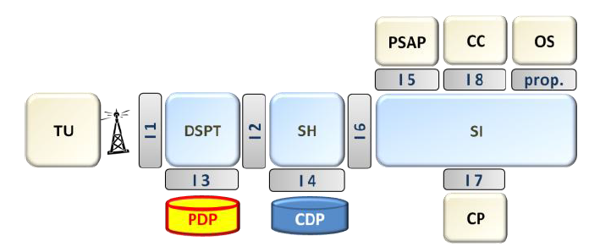
Building blocks (cont.)
Keep DSPT flexible by holding provisioned (by OEM, TU manufacturer) data
How to reach the TU (IP-address, IMSI)
Encryption (algorithm to use, keys)
Latest channel used by the TU (UDP, SMS,...)
Which component to trigger on incoming messages
Provisioning Data Provider

Slide 15
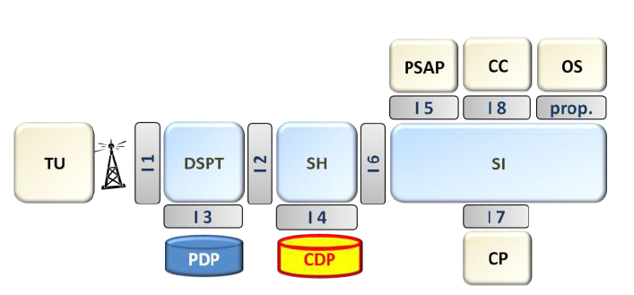
Building blocks (cont.)
Keep customer & vehicle related data relevant for a service
Independent from services (different services can reuse same data from CDP)
Custom Data Provider

Slide 16
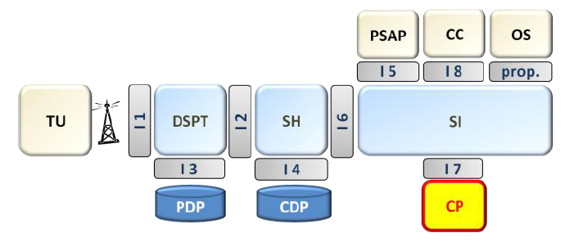
Building blocks (cont.)
Content dispatcher (query content from other sources depends on request from TU)
Content includes: POI, weather forecast, traffic fules,...
Can hold online or offline (in database) content
Content Provider

Slide 17
Agenda
Overview
Building blocks
Design & communication concepts
Interfaces
General aspects
TSDP
LGE NGTP services
Vehicle interface
ASN.1
NGTP messages

Slide 18
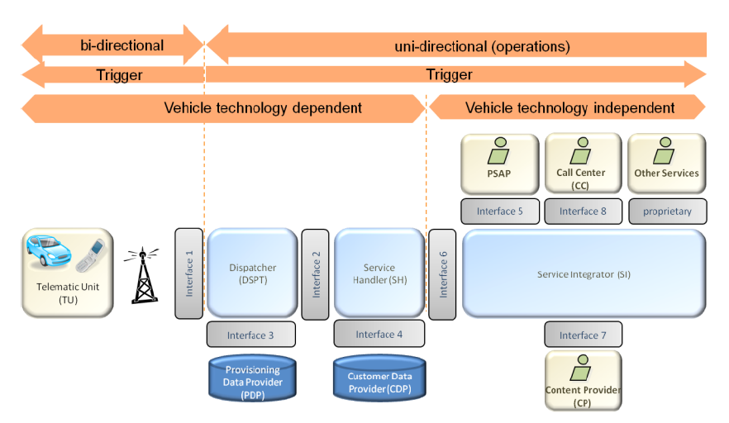
Design & communication concepts
Design
Event
…
Communication
Trigger
Operation

Slide 19
Design & communication concepts
(cont.)
Communication
Uni-directional (except IF#1 & IF#8)
Trigger
Originated from DSPT only (to other higher components in NGTP stack)
Unique by Event
Operation
Or method (from programming/technical point of view)
Provided/implemented by interfaces (later)
Call by some to retrieve info from others after receiving
Trigger

Slide 20
Design & communication concepts
(cont.)
Design
Event
A use case, for e.g.: User (TU) establish an emergency call, or NGTP backend establish an update request to software @ TU side,…
Defined by an unique ID (later)
Multiple message can belong to same event

Slide 21
Agenda
Overview
Building blocks
Design & communication concepts
Interfaces
General aspects
TSDP
LGE NGTP services
Vehicle interface
ASN.1
NGTP messages

Slide 22
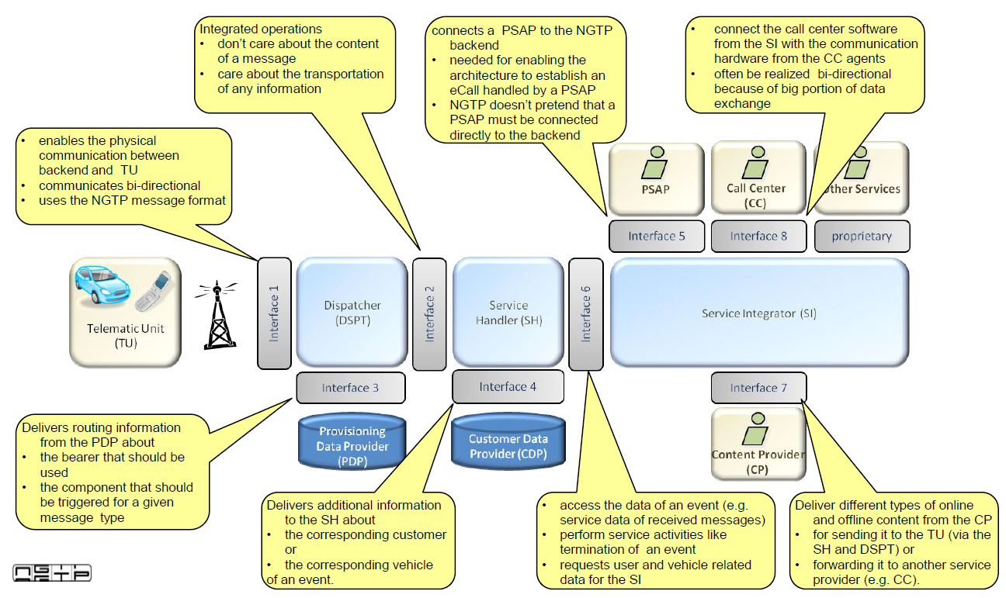
Interfaces
Define operations
Operations are services (methods, APIs) provided by lower level to higher level components within NGTP stack
Naming convention (name indicates direction from low to high component)
Mostly uni-directional

Slide 23
Interfaces (cont.)
Focus on this only (later)

Slide 24
Agenda
Overview
Building blocks
Design & communication concepts
Interfaces
General aspects
TSDP
LGE NGTP services
Vehicle interface
ASN.1
NGTP messages

Slide 25
General aspects
Aspects need to be considered when design a telematics system obeys NGTP principles
Just guidelines & recommendations
Security
Secured communication channel like SSL
End-to-end data encryption
Authentication
…
Logging
Timestamp
Event ID
Distributed logging
Centralized logging
…
Monitoring
Failure detection
Diagnosis of issues
…

Slide 26
Agenda
Overview
Building blocks
Design & communication concepts
Interfaces
General aspects
TSDP
LGE NGTP services
Vehicle interface
ASN.1
NGTP messages

Slide 27
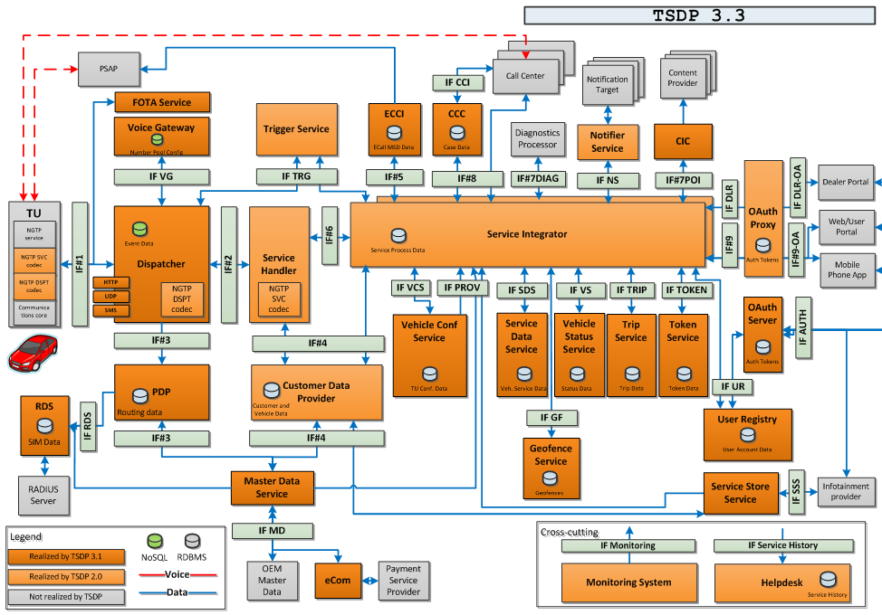
TSDP
Telematics Services Delivery Platform
A name given by WirelessCar (WC) for its implementation of NGTP infrastructure
Components and their roles are as same as described in previous sections
Plus other components

Slide 28
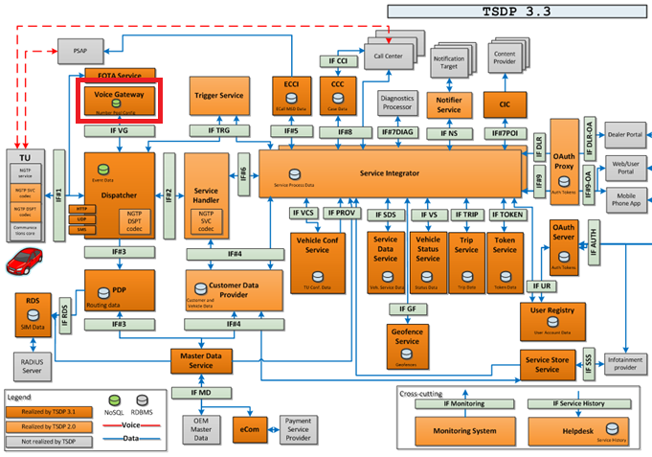
TSDP (cont.)
Voice Gateway
Allocate & store phone numbers for e-call, b-call (CRQNs – Call Request Numbers)
Decide & forward CRQNs to DSPT that send back for TU to use

Slide 29
TSDP (cont.)
Add & store vehicle profile, TU profile
Vehicle profile added by JLR system
TU profile added by LGE
Vehicle profile & TU profile will be connected (programmatically) when running provisioning application (FT) within VDC
Master Data Service

Slide 30
Agenda
Overview
Building blocks
Design & communication concepts
Interfaces
General aspects
TSDP
LGE NGTP services
Vehicle interface
ASN.1
NGTP messages

Slide 31
LGE NGTP service
As said earlier…
Focus on this only (later)

Slide 32
LGE NGTP service (cont.)
Handle HEADER of NGTP message only
Dispatch messages to other components
Send messages from other components to TU
Able to handle of both voice and data messages
Able to switch bearer (SMS, WLAN,…)
Messages are downlink (MT)
Multiple protocols: UDP, HTTP/HTTPS (over TCP), SMS
Resending mechanism stop after receiving DSPT ACK
Encryption/decryption of messages
As said earlier…
Dispatcher
LGE NGTP service resides in here

Slide 33
LGE NGTP service (cont.)
That means:
Handle HEADER of NGTP message only
Dispatch messages to other components (applications within TU that sent corresponding message)
Send messages from other components (applications within TU) to DSPT
Able to handle of both voice and data messages
Able to switch bearer (SMS, WLAN,…)
Messages are uplink (MO)
Multiple protocols: UDP, HTTP/HTTPS (over TCP), SMS
Resending mechanism stop after receiving DSPT ACK
Encryption/decryption of messages
And many more that specific to JLR requirements…
Handle HEADER of NGTP message only
Dispatch messages to other components
Send messages from other components to TU
Able to handle of both voice and data messages
Able to switch bearer (SMS, WLAN,…)
Messages are downlink (MT)
Multiple protocols: UDP, HTTP/HTTPS (over TCP), SMS
Resending mechanism stop after receiving DSPT ACK
Encryption/decryption of messages
WC Dispatcher
LGE NGTP service resides in here

Slide 34
LGE NGTP service (cont.)
LGE NGTP service
resides in here
SVC CODEC
Component defines structure/format for SERVICE section of a NGTP message
Know how to encode/decode that section
Provided by 3rd party (later)
DSPT CODEC
Component defines structure/format for HEADER section of a NGTP message
Know how to encode/decode that section
Provided by 3rd party (later)

Slide 35


LGE NGTP service (cont.)
What’s about data encryption?
What’s about data communication over the Internet?
© Image courtesy of Google Images

Slide 36
LGE NGTP service (cont.)
In summary
TU (JLR VDC)
App (service)
App (service)
App (service)
NGTP service
IF#1
WC DSPT
CURL
Its own logic
OpenSSL
SVC & DSPT CODEC

Slide 37
Agenda
Overview
Building blocks
Design & communication concepts
Interfaces
General aspects
TSDP
LGE NGTP services
Vehicle interface
ASN.1
NGTP messages

Slide 38
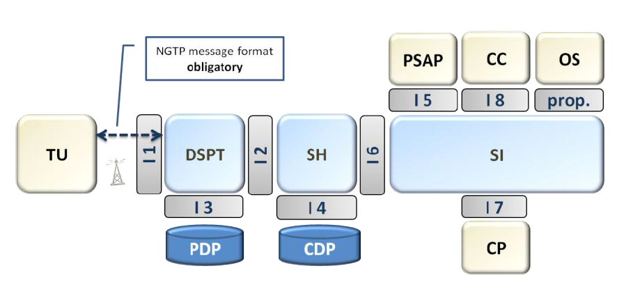
Vehicle interface
A.K.A IF#1
Bi-directional
Located @ NGTP backend
Vehicle profile added by JLR system
TU profile added by LGE
Vehicle profile & TU profile will be connected (programmatically) when running provisioning application within VDC

Slide 39
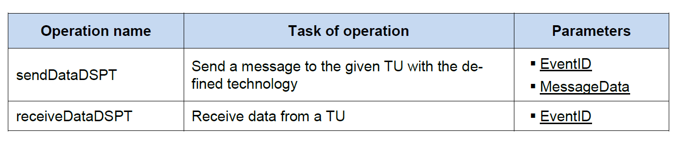
Vehicle interface (cont.)

Slide 40
Agenda
Overview
Building blocks
Design & communication concepts
Interfaces
General aspects
TSDP
LGE NGTP services
Vehicle interface
ASN.1
NGTP messages

Slide 41
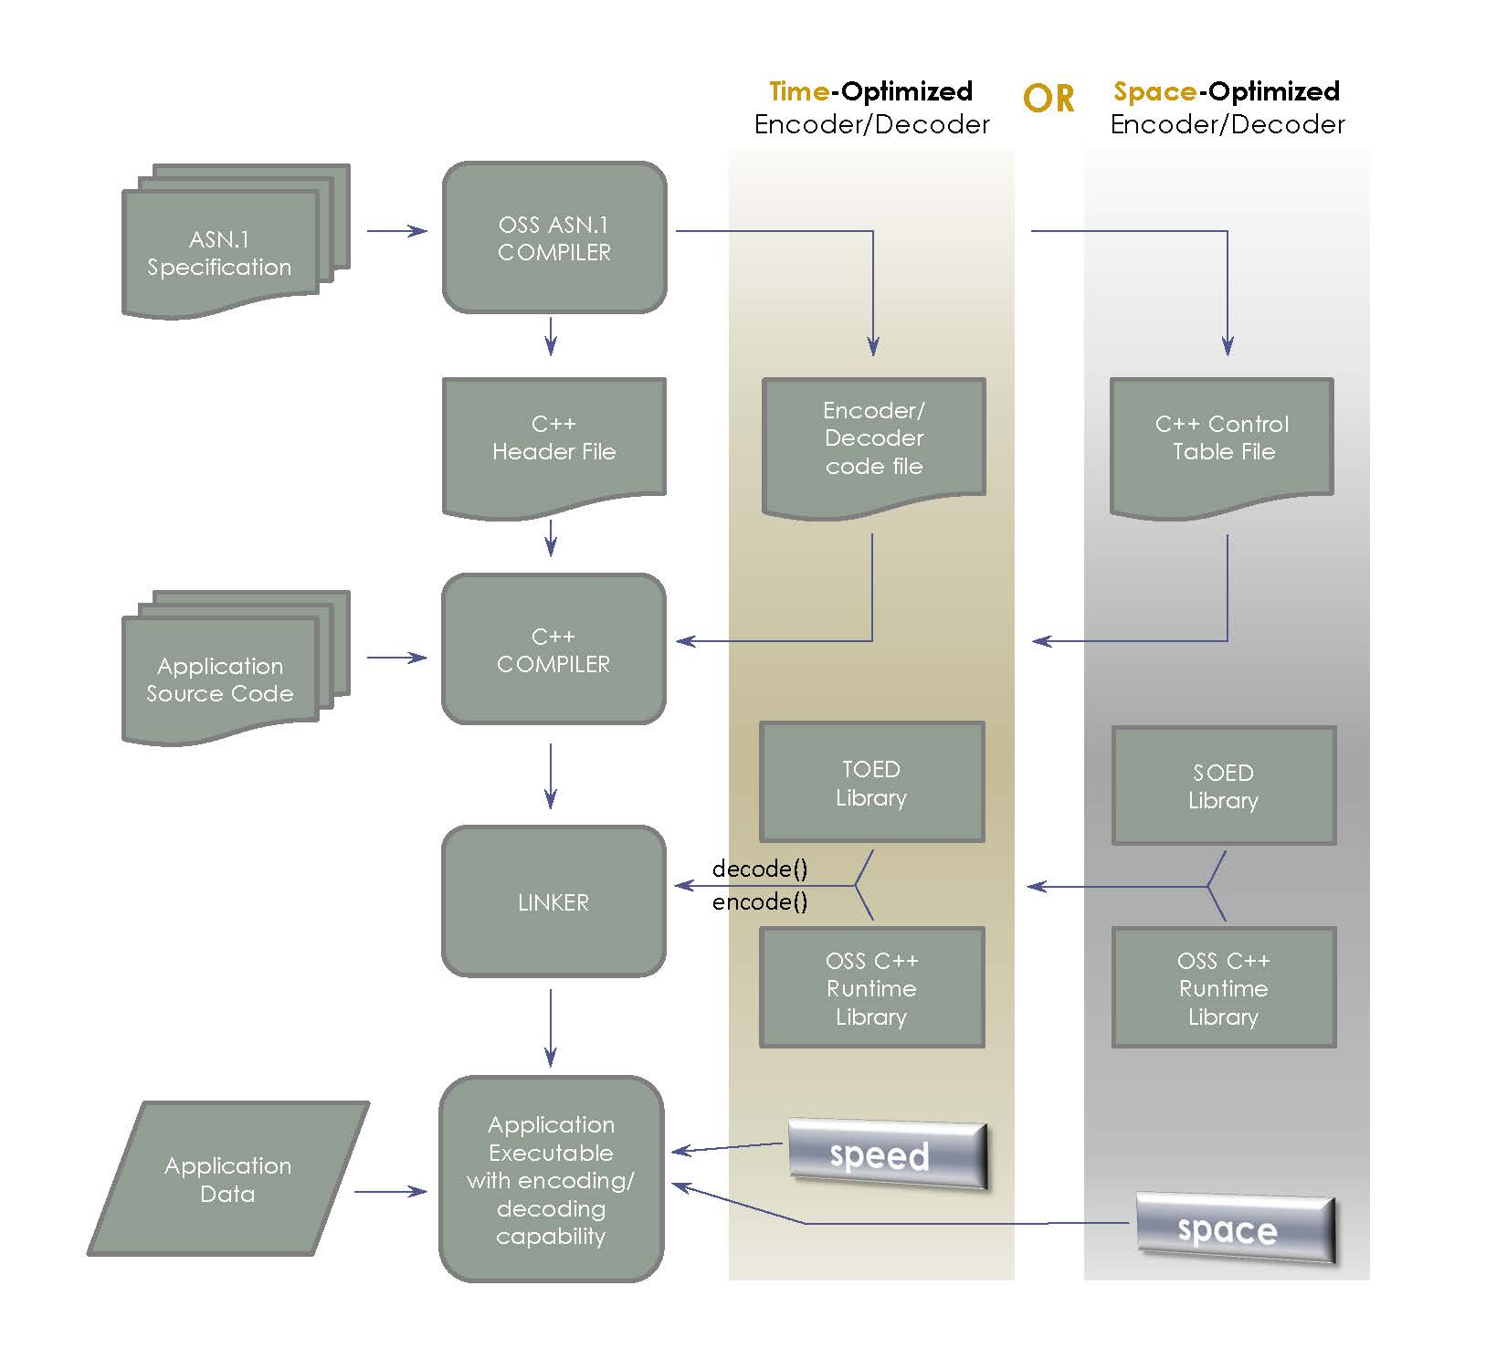
Vehicle interface (cont.)
ASN.1
https://www.oss.com/asn1/products/asn1-cpp/asn1-cpp.html
IF#1 uses ASN.1. to (recursively) define structure of a NGTP message
Name
Type
Length
…
Tools to generate ASN.1 format to difference programming language

Slide 42
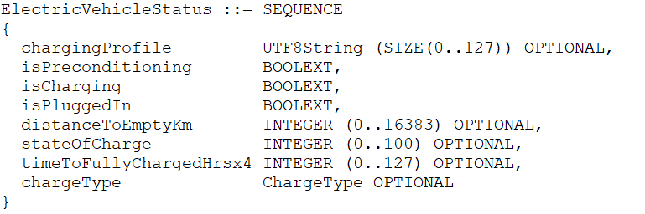
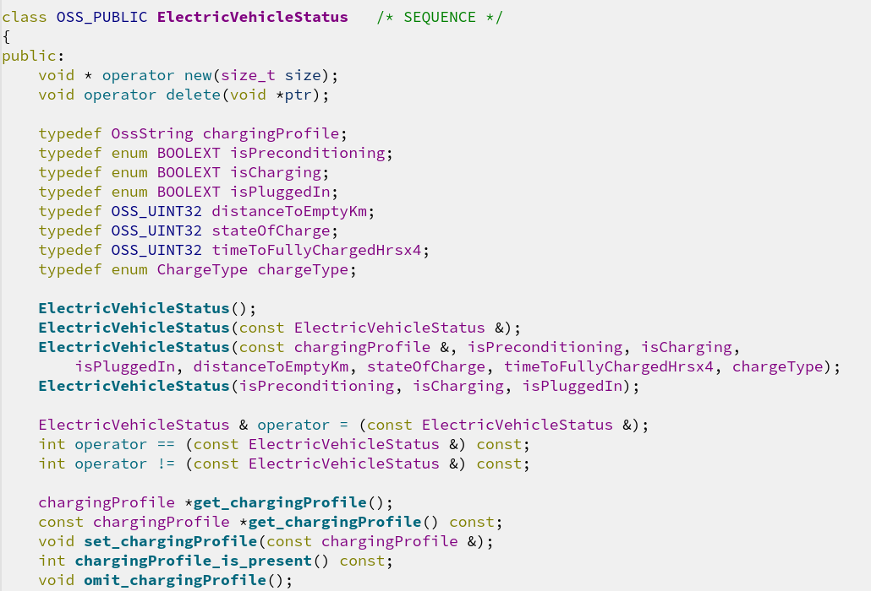
Vehicle interface (cont.)
ASN.1 (cont.)
https://www.oss.com/asn1/products/asn1-cpp/asn1-cpp.html
ASN.1 Compiler

Slide 43
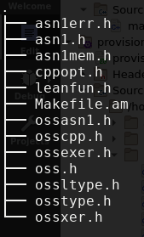

Vehicle interface (cont.)
ASN.1 (cont.)
https://www.oss.com/asn1/products/asn1-cpp/asn1-cpp.html
SVC CODEC said earlier
Specified by JLR
Discuss with LGE & WC
Provided by OSS NOKALVA, INC.
ASN.1 Compiler

Slide 44

Vehicle interface (cont.)
ASN.1 (cont.)
https://www.oss.com/asn1/products/asn1-cpp/asn1-cpp.html
DSPT CODEC said earlier
Provided by OSS NOKALVA, INC.

Slide 45
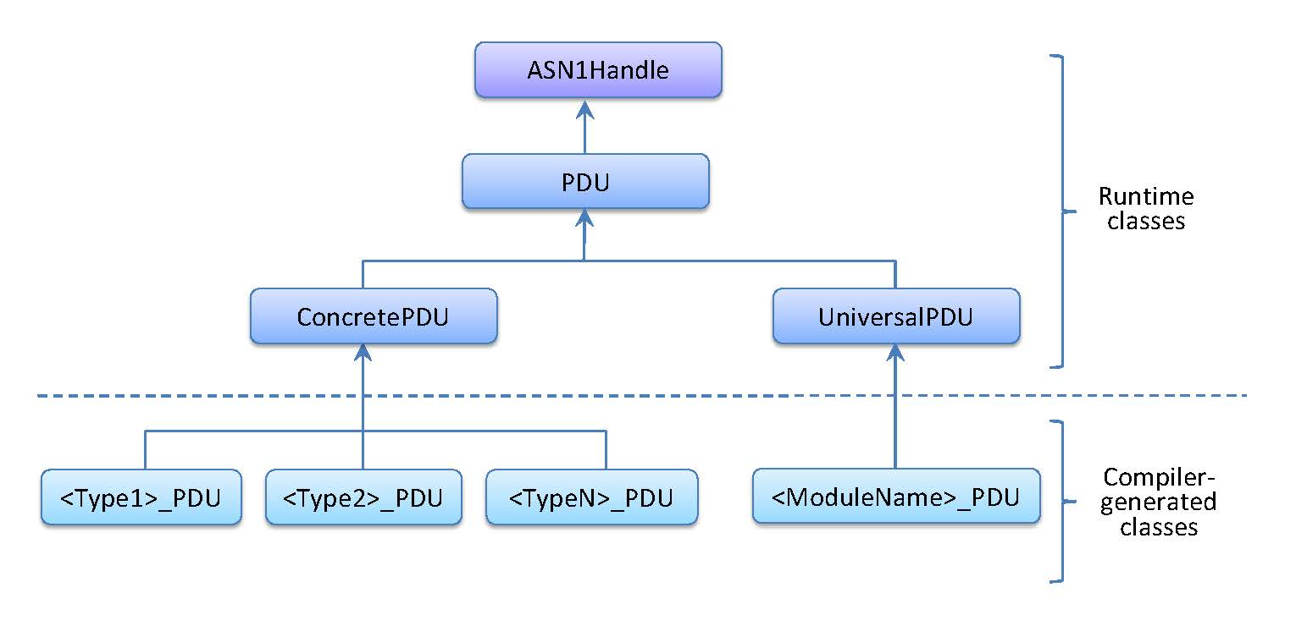
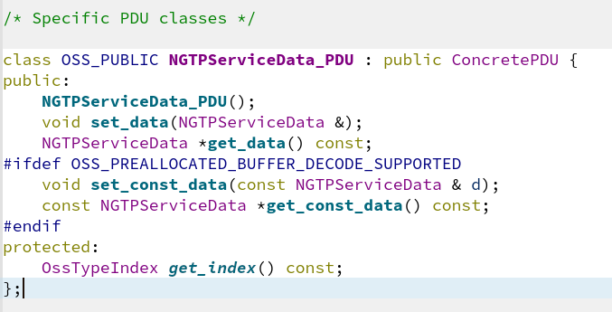
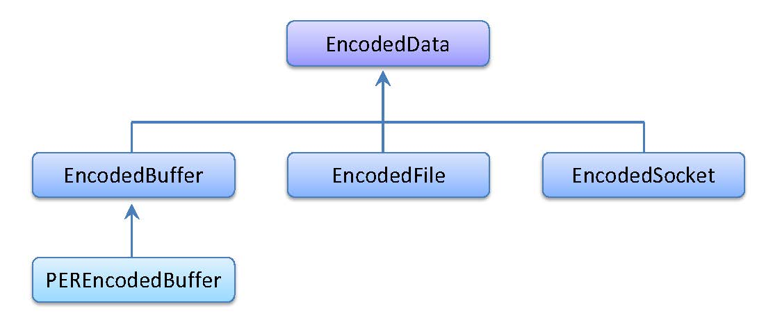
Vehicle interface (cont.)
ASN.1 (cont.)
https://www.oss.com/asn1/products/asn1-cpp/asn1-cpp.html
Hierarchical structure
Encoding/decoding, printing, error handling,…

Slide 46
Agenda
Overview
Building blocks
Design & communication concepts
Interfaces
General aspects
TSDP
LGE NGTP services
Vehicle interface
ASN.1
NGTP messages

Slide 47
NGTP Message
Defined by ASN.1 notation
Packed Encoding Rules Unaligned (PER/U) is used for binary encoding of payload data
Efficiently minimizing payload data
Low TU resource requirements
Section | Transport header | Message header | Dispatcher Data Unencrypted | Dispatcher Data | Dispatcher Signature | Service Data | Message Signature
Size (bytes) | 3 | 5 | Variable | Variable | Variable | Variable | Variable

Slide 48
NGTP Message (cont.)
Defined by ASN.1 notation
Packed Encoding Rules Unaligned (PER/U) is used for binary encoding of payload data
Efficiently minimizing payload data
Low TU resource requirements
Section | Transport header | Message header | Dispatcher Data Unencrypted | Dispatcher Data | Dispatcher Signature | Service Data | Message Signature
Size (bytes) | 3 | 5 | Variable | Variable | Variable | Variable | Variable

Slide 49
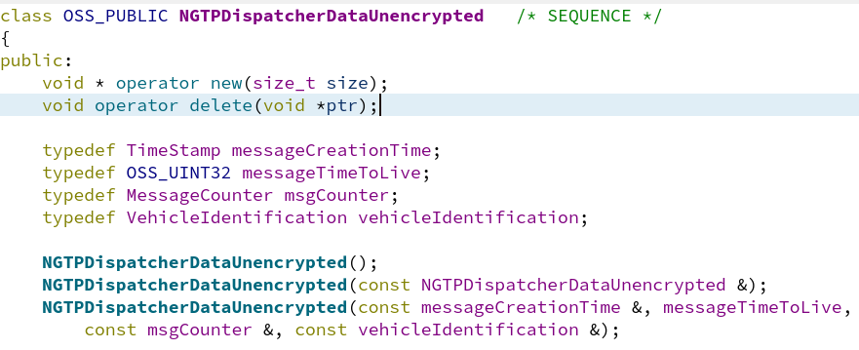
NGTP Message (cont.)
Section | Transport header | Message header | Dispatcher Data Unencrypted | Dispatcher Data | Dispatcher Signature | Service Data | Message Signature
Size (bytes) | 3 | 5 | Variable | Variable | Variable | Variable | Variable
DDU
To retrieve crypto key from the PDP (together with the data in the security context)
To be able to throw away ”old” messages without having to decrypt the full message.
NGTPDispatcherDataUnencrypted ::= SEQUENCE {
messageCreationTime TimeStamp,
messageTimeToLive INTEGER(0..2047),
msgCounter MessageCounter,
vehicleIdentification VehicleIdentification
}

Slide 50
NGTP Message (cont.)
Section | Transport header | Message header | Dispatcher Data Unencrypted | Dispatcher Data | Dispatcher Signature | Service Data | Message Signature
Size (bytes) | 3 | 5 | Variable | Variable | Variable | Variable | Variable
DDU – Message Creation Time
-- Time when this message was created by the dispatcher part creator.
-- The sender must ensure that a timestamp is never reused for a specific car
messageCreationTime TimeStamp, --41bit
TimeStamp ::= SEQUENCE {
seconds INTEGER(0..2147483647), -- UTC seconds since January 1st, 2000, 00:00 (31 Bit)
millis INTEGER(0..999) OPTIONAL -- Millisecond within the second
}
It is very important that the message creation time is not reused for a specific vehicle.
This is so because the dispatcher will not pass on a message having the same message creation time as a message it has already processed.
Also very important because the security of the encryption requires the initialization vector (IV) to be unique (per encryption key), and the message creation time is part of the IV.

Slide 51
NGTP Message (cont.)
Section | Transport header | Message header | Dispatcher Data Unencrypted | Dispatcher Data | Dispatcher Signature | Service Data | Message Signature
Size (bytes) | 3 | 5 | Variable | Variable | Variable | Variable | Variable
DDU – Message Time To Live
messageTimeToLive INTEGER(0..2047), --In steps of 10s. 0=no limit
Configurable by service type. E.g. an e-call should have longer TTL than others

Slide 52
NGTP Message (cont.)
Section | Transport header | Message header | Dispatcher Data Unencrypted | Dispatcher Data | Dispatcher Signature | Service Data | Message Signature
Size (bytes) | 3 | 5 | Variable | Variable | Variable | Variable | Variable
DDU – Message Counter
-- The message counter is incremented for each new message sent, except for the
-- Dispatcher Ack where the received message counter is returned.
-- Each side has its own message counter
msgCounter MessageCounter,
MessageCounter ::= SEQUENCE {
uplinkCount INTEGER (0..255),
downlinkCount INTEGER (0..255)
}
Used to correlate requests and ACKs.
When the TU sends a new message, the uplinkCount should be increased.
When TSP sends a new message, the downlinkCount should be increased.
When TSP sends an app ack to TU, the uplinkCount should have the same value as the message that is acknowledged.

Slide 53

NGTP Message (cont.)
Section | Transport header | Message header | Dispatcher Data Unencrypted | Dispatcher Data | Dispatcher Signature | Service Data | Message Signature
Size (bytes) | 3 | 5 | Variable | Variable | Variable | Variable | Variable
DDU – Message Counter (cont.)
From an application point-of-view the meaning of Application Acknowledgement(AppAck) and Dispatcher Acknowledgement (DsptAck) can be described like this:
DsptAck – I have received your message and stored it reliably. It will be processed sometime in the future (normally within milliseconds). The DsptAck is sent from the Dispatcher.
AppAck – I have received your message and fully processed it. The AppAck is sent from the implementing Domain Service.
Both are configurable in NGTP message: AppAckRequired (Boolean), DsptAckRequired (Boolean)

Slide 54
NGTP Message (cont.)
Section | Transport header | Message header | Dispatcher Data Unencrypted | Dispatcher Data | Dispatcher Signature | Service Data | Message Signature
Size (bytes) | 3 | 5 | Variable | Variable | Variable | Variable | Variable
DDU – Vehicle Identification
--This field is added here to make it possible to identify the sender
--even for an encrypted message over a public APN.
vehicleIdentification VehicleIdentification
VehicleIdentification ::= CHOICE {
vin VIN,
--driveID can be used as an “anonymous” identifier. Currently not used.
driveID PrintableString (SIZE(17)),
--Generic equipment id. Used if provisioned by TSP.
equipmentId INTEGER(0..4294967295),
--Equipment serial number
equipmentSerial PrintableString (SIZE(10..20))
}
EquipmentSerial is used when performing a factory test (FT). VIN included in the service data.
TSP generates an equiment ID for a vehicle from the VIN when running FT.
The equipment ID is sent back to TU in the FT process.
The equipment ID is always used between the TU and the dispatcher after the FT has been performed.
The PDP holds a mapping equipment ID → VIN.
VIN is used in the rest of the TSDP stack.

Slide 55
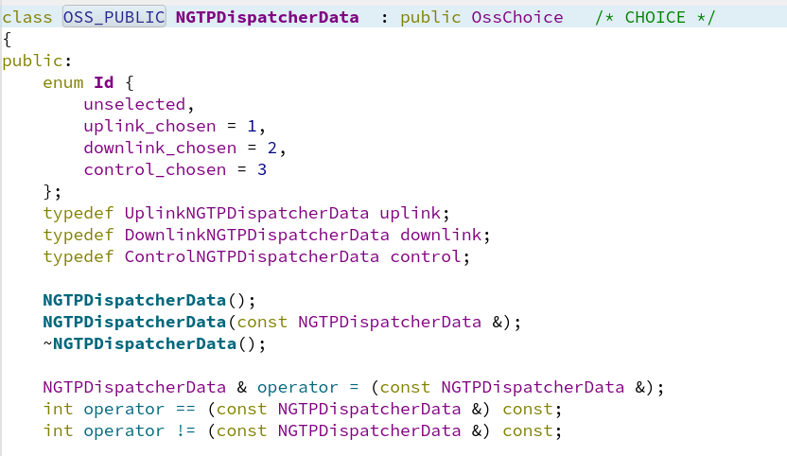
NGTP Message (cont.)
Section | Transport header | Message header | Dispatcher Data Unencrypted | Dispatcher Data | Dispatcher Signature | Service Data | Message Signature
Size (bytes) | 3 | 5 | Variable | Variable | Variable | Variable | Variable
DD
Can be of three types
Uplink
Downlink
Control
NGTPDispatcherData ::= CHOICE {
uplink UplinkNGTPDispatcherData, -- for ServiceDataMessages
downlink DownlinkNGTPDispatcherData,-- for ServiceDataMessages
control ControlNGTPDispatcherData -- for both downlink and uplink
}

Slide 56
NGTP Message (cont.)
Section | Transport header | Message header | Dispatcher Data Unencrypted | Dispatcher Data | Dispatcher Signature | Service Data | Message Signature
Size (bytes) | 3 | 5 | Variable | Variable | Variable | Variable | Variable
DD (cont.)
Each message type consists of a common part (included in all types) and one specific part.
UplinkNGTPDispatcherData ::= SEQUENCE {
common NGTPDispatcherDataCommon,
extension UplinkNGTPDispatcherDataExtension
}
DownlinkNGTPDispatcherData ::= SEQUENCE {
common NGTPDispatcherDataCommon,
extension DownlinkNGTPDispatcherDataExtension
}
ControlNGTPDispatcherData ::= SEQUENCE {
common NGTPDispatcherDataCommon,
extension ControlNGTPDispatcherDataExtension
}

Slide 57
NGTP Message (cont.)
Section | Transport header | Message header | Dispatcher Data Unencrypted | Dispatcher Data | Dispatcher Signature | Service Data | Message Signature
Size (bytes) | 3 | 5 | Variable | Variable | Variable | Variable | Variable
DD (cont.)
Each message type consists of a common part (included in all types) and one specific part.
UplinkNGTPDispatcherData ::= SEQUENCE {
common NGTPDispatcherDataCommon,
extension UplinkNGTPDispatcherDataExtension
}
DownlinkNGTPDispatcherData ::= SEQUENCE {
common NGTPDispatcherDataCommon,
extension DownlinkNGTPDispatcherDataExtension
}
ControlNGTPDispatcherData ::= SEQUENCE {
common NGTPDispatcherDataCommon,
extension ControlNGTPDispatcherDataExtension
}
NGTPDispatcherDataCommon ::= SEQUENCE {
eventInitiator EventInitiator,
eventCreationTime TimeStamp,
serviceType INTEGER (0..255),
messageType DSPTMessageType,
dsptAckRequired BOOLEAN,
statelessNGTPmessage BOOLEAN,
...
}

Slide 58
NGTP Message (cont.)
Section | Transport header | Message header | Dispatcher Data Unencrypted | Dispatcher Data | Dispatcher Signature | Service Data | Message Signature
Size (bytes) | 3 | 5 | Variable | Variable | Variable | Variable | Variable
DD (cont.)
Common – Even Initiator
--Where was the event started eventInitiator EventInitiator, --1
bitEventInitiator ::= ENUMERATED {
tu (0),
backend (1)
}
Should indicate if the message was created by the TU (bit set to 0) or by the TSP (bit set to 1).

Slide 59
NGTP Message (cont.)
Section | Transport header | Message header | Dispatcher Data Unencrypted | Dispatcher Data | Dispatcher Signature | Service Data | Message Signature
Size (bytes) | 3 | 5 | Variable | Variable | Variable | Variable | Variable
DD (cont.)
Common – Even Creation Time
eventCreationTime TimeStamp,
Timestamp indicating when the event that the message belongs to was created.
All messages belonging to the same event should have the same eventCreationTime.
Messages belonging to different events must have different messageCreationTimes.
The dispatcher uses the eventCreationTime to find out which event a message belongs to.

Slide 60
NGTP Message (cont.)
Section | Transport header | Message header | Dispatcher Data Unencrypted | Dispatcher Data | Dispatcher Signature | Service Data | Message Signature
Size (bytes) | 3 | 5 | Variable | Variable | Variable | Variable | Variable
DD (cont.)
Common – Service Type
-- A value from ApplicationServiceType in separate ---- asn.1 file
serviceType INTEGER (0..255),
From TU (JLR TCU) point of view, services are applications run above (and therefore use) NGTP service’s APIs
Passed on from the dispatcher to the SH
Service Name | Value
ECALL | 1
BCALL | 5
SVT | 15
… | …

Slide 61
NGTP Message (cont.)
Section | Transport header | Message header | Dispatcher Data Unencrypted | Dispatcher Data | Dispatcher Signature | Service Data | Message Signature
Size (bytes) | 3 | 5 | Variable | Variable | Variable | Variable | Variable
DD (cont.)
Common – Message Type
messageType DSPTMessageType
DSPTMessageType ::= ENUMERATED {
...
upServiceData (2),
downServiceData (3),
dsptAck (4),
...
-- 11 to 31 is reserved

Slide 62
NGTP Message (cont.)
Section | Transport header | Message header | Dispatcher Data Unencrypted | Dispatcher Data | Dispatcher Signature | Service Data | Message Signature
Size (bytes) | 3 | 5 | Variable | Variable | Variable | Variable | Variable
DD (cont.)
Common – Dispatcher Ack Required
dsptAckRequired BOOLEAN,
Determines if a dispatcher ACK should be sent in response to this message.

Slide 63
NGTP Message (cont.)
Section | Transport header | Message header | Dispatcher Data Unencrypted | Dispatcher Data | Dispatcher Signature | Service Data | Message Signature
Size (bytes) | 3 | 5 | Variable | Variable | Variable | Variable | Variable
DD (cont.)
Common – Stateless NGTP Message
-- statelessNGTPmessage TRUE is used in a message not -- expecting any response.
statelessNGTPmessage BOOLEAN,
Stateless
Stateful
Does not expect for response
Will be forgotten when received DSPT ACK
Expect for response
Ended when either side (TU or DSPT) sends Terminate message
Those are called communication flow
4 types in total (TU <-> DSPT)

Slide 64
NGTP Message (cont.)
Section | Transport header | Message header | Dispatcher Data Unencrypted | Dispatcher Data | Dispatcher Signature | Service Data | Message Signature
Size (bytes) | 3 | 5 | Variable | Variable | Variable | Variable | Variable
DD (cont.)
Let come back to Event
Event
A use case, for e.g.: User (TU) establish an emergency call, or NGTP backend establish an update request to software @ TU side,…
Defined by an unique ID (later)
Multiple message can belong to same event
In JLR VDC – WC NGTP, I think Event is combination of what already mentioned in NGTPDispatcherDataCommon(DD) + Equipment ID (DDU)

Slide 65
Others need to be investigated
Transport support within NGTP service & DSPT (NGTP backend)
UDP
HTTP/HTTPS (over TCP)
...
Retry mechanism
Messages fragmentation and resemblance
Security (encryption & decryption of a NGTP message)
...

